Slide 1




Title: Analysis of Amazon Sales Data
Course: AI
Organization: Nirmaan

Slide 2
Introduction
Sales management has gained importance to meet increasing competition and the need for improved methods of distribution to reduce cost and to increase profits.
Sales management today is the most important function in a commercial and business enterprise.

Slide 3
Contents
Objective
Constraints
Data collection and details
Exploratory Data Analysis
Visualization
Insights
Notes:
Change

Slide 4
Objective
Problem
Sales management has gained importance to meet increasing competition.
Objective of this project
Maximize the profits
Constraints
Minimize the cost
Notes:
Change

Slide 5
These are the below Methodologies
1. Data understanding
2. Data preparation / Data Preprocessing / Data Cleansing
3. Exploratory Data Analysis
4. Data Visualization 5. Insights
Methodology

Slide 6
Technical Stacks
1) ETL - Extract, Transform and Load process is used.
2) Key Metrics – Total Sales, Average Sales.
3) Libraries used – pandas, NumPy, matplotlib, seaborn
4) Visualization – Pair plots, Line plots

Slide 7
Data Collection and Understanding
Data Collection: Amazon Sales Dataset
Our Dataset is an excel file that contains the amazon sales details.

Slide 8
Data Preprocessing & EDA
Data Loading:
The dataset is loaded and we are dropping the missing values.
Data Transformation:
Creating new columns like Month, Year.
Data Extraction:
Calculating the monthly sales, yearly sales and yearly-month-wise sales.
Below is the code:
link
Notes:
Keep observations

Slide 9
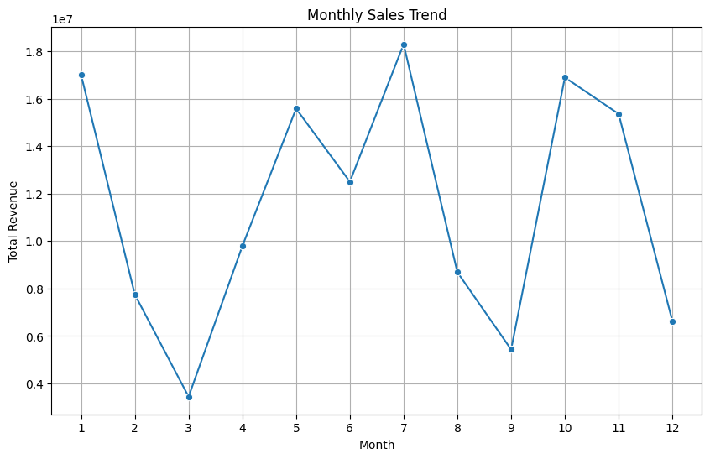
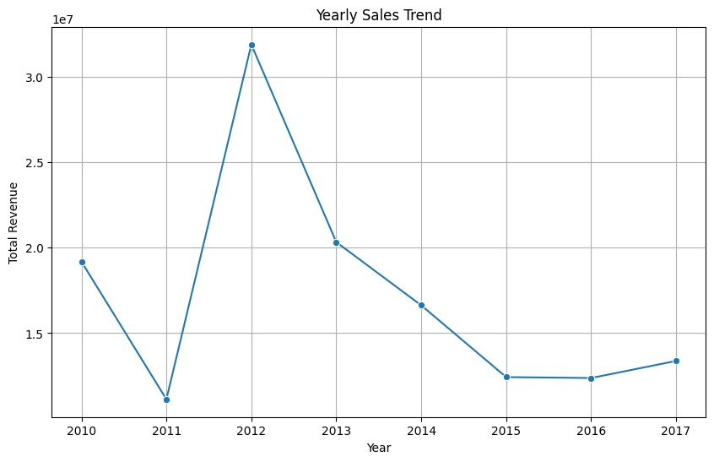
Data Visualization
Monthly and Yearly Sales Trends Visualization
Notes:
Keep observations

Slide 10
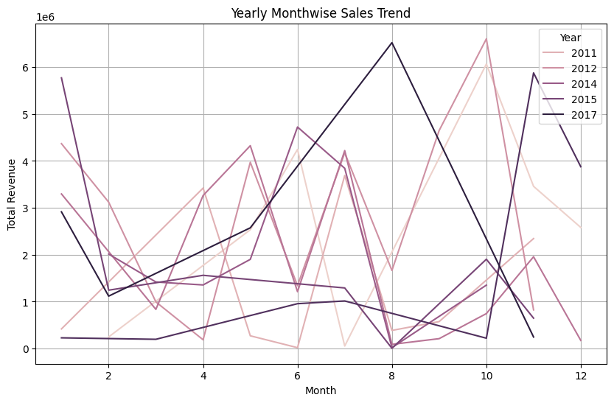
Data Visualization
Yearly – Month – Wise Sales Trends Visualization
Notes:
Keep observations

Slide 11
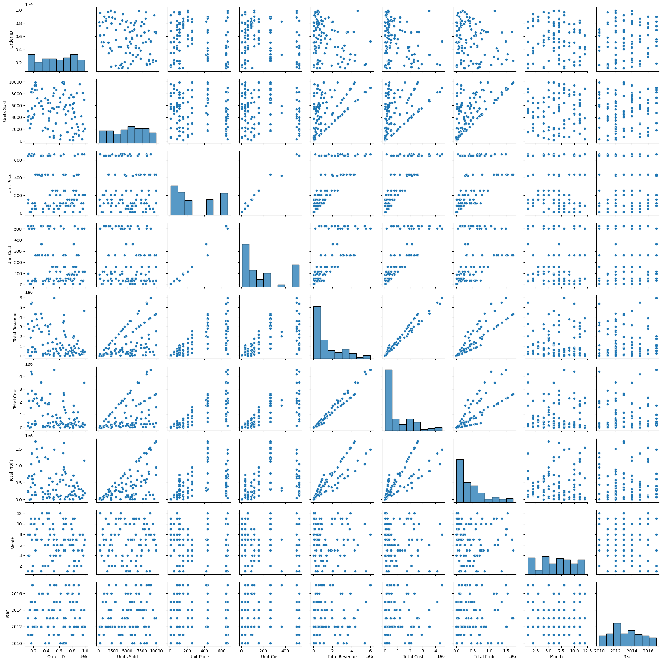
Output
Pair Plots Visualization for detecting the correlation between all attributes.

Slide 12
Insights
Monthly Sales Analysis -> Based on the monthly sales trend, the sales are good initially during January and are at peak in July, but are at the lowest at December.
Yearly Sales Analysis -> Based on the yearly sales trend, the sales are at a medium level in the year 2010, they are at peak in the year and are at the lowest in 2017.
Yearly Month wise Sales Analysis -> Based on the yearly month wise sales trend, during the years 2011 and 2017, especially during August and October, the sales are at peak. Whereas, in the years 2014 and 2017, and the months November and December, the sales are at the minimum.

Slide 13
Thank You

